Slide 1
HASNAIN ALI KHAN
INSTITUTE OF MANAGEMENT SCIENCES

Slide 2
VMware and Dual Boot
Exploring Virtualization and Operating Systems

Slide 3


Introduction to VMware
VMware is a leading provider of virtualization software.
It allows users to run multiple operating systems on a single physical machine.
It creates virtual machines to enable users to run multiple OSes.
WINDOWS
LINUX
ANDROID

Slide 4


What is Dual Boot?
Dual booting enables a user to install and use two operating systems on one computer.
Users can choose which OS to boot into at startup.
With Dual booting the user can only access one OS at a time.
THE PC
NEEDS
TO BE
REBOOTED

Slide 5
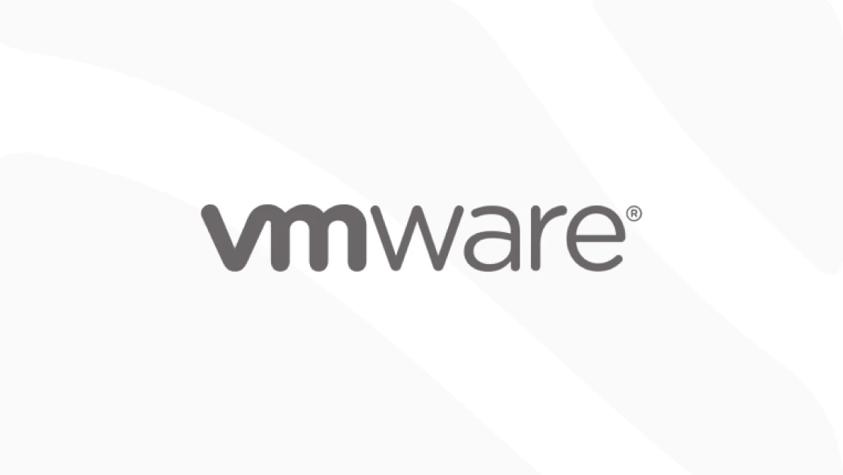
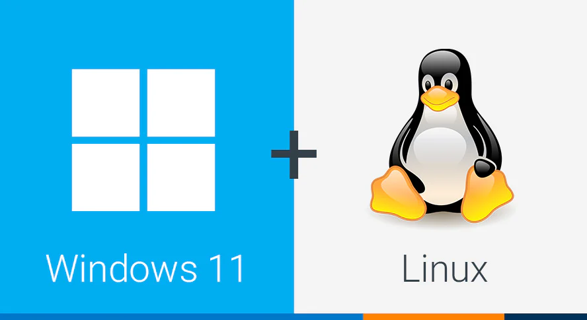
Difference between vmware and dual boot
VMWARE
DUAL BOOT
Multiple operating systems at the same time.
Switch between OSes.
Provides convenience.
Only one Operating system at a time.
Reboot to switch OSes.
Provides performance.

Slide 6
Benefits of vmware and dual boot
Resource Efficiency: Utilize hardware effectively with multiple OSes.
Testing and Development: Easily test software in different environments.
Flexibility: Access applications exclusive to a specific OS.

Slide 7
thankyou

